Slide 1
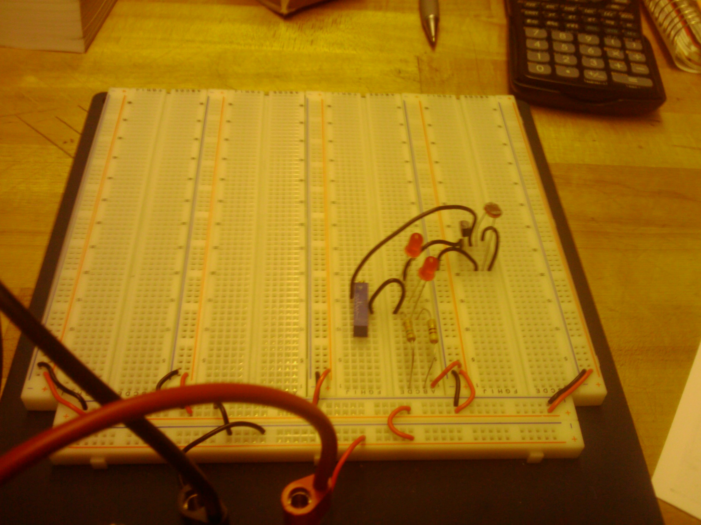
Photocell Lab - Off

Slide 2
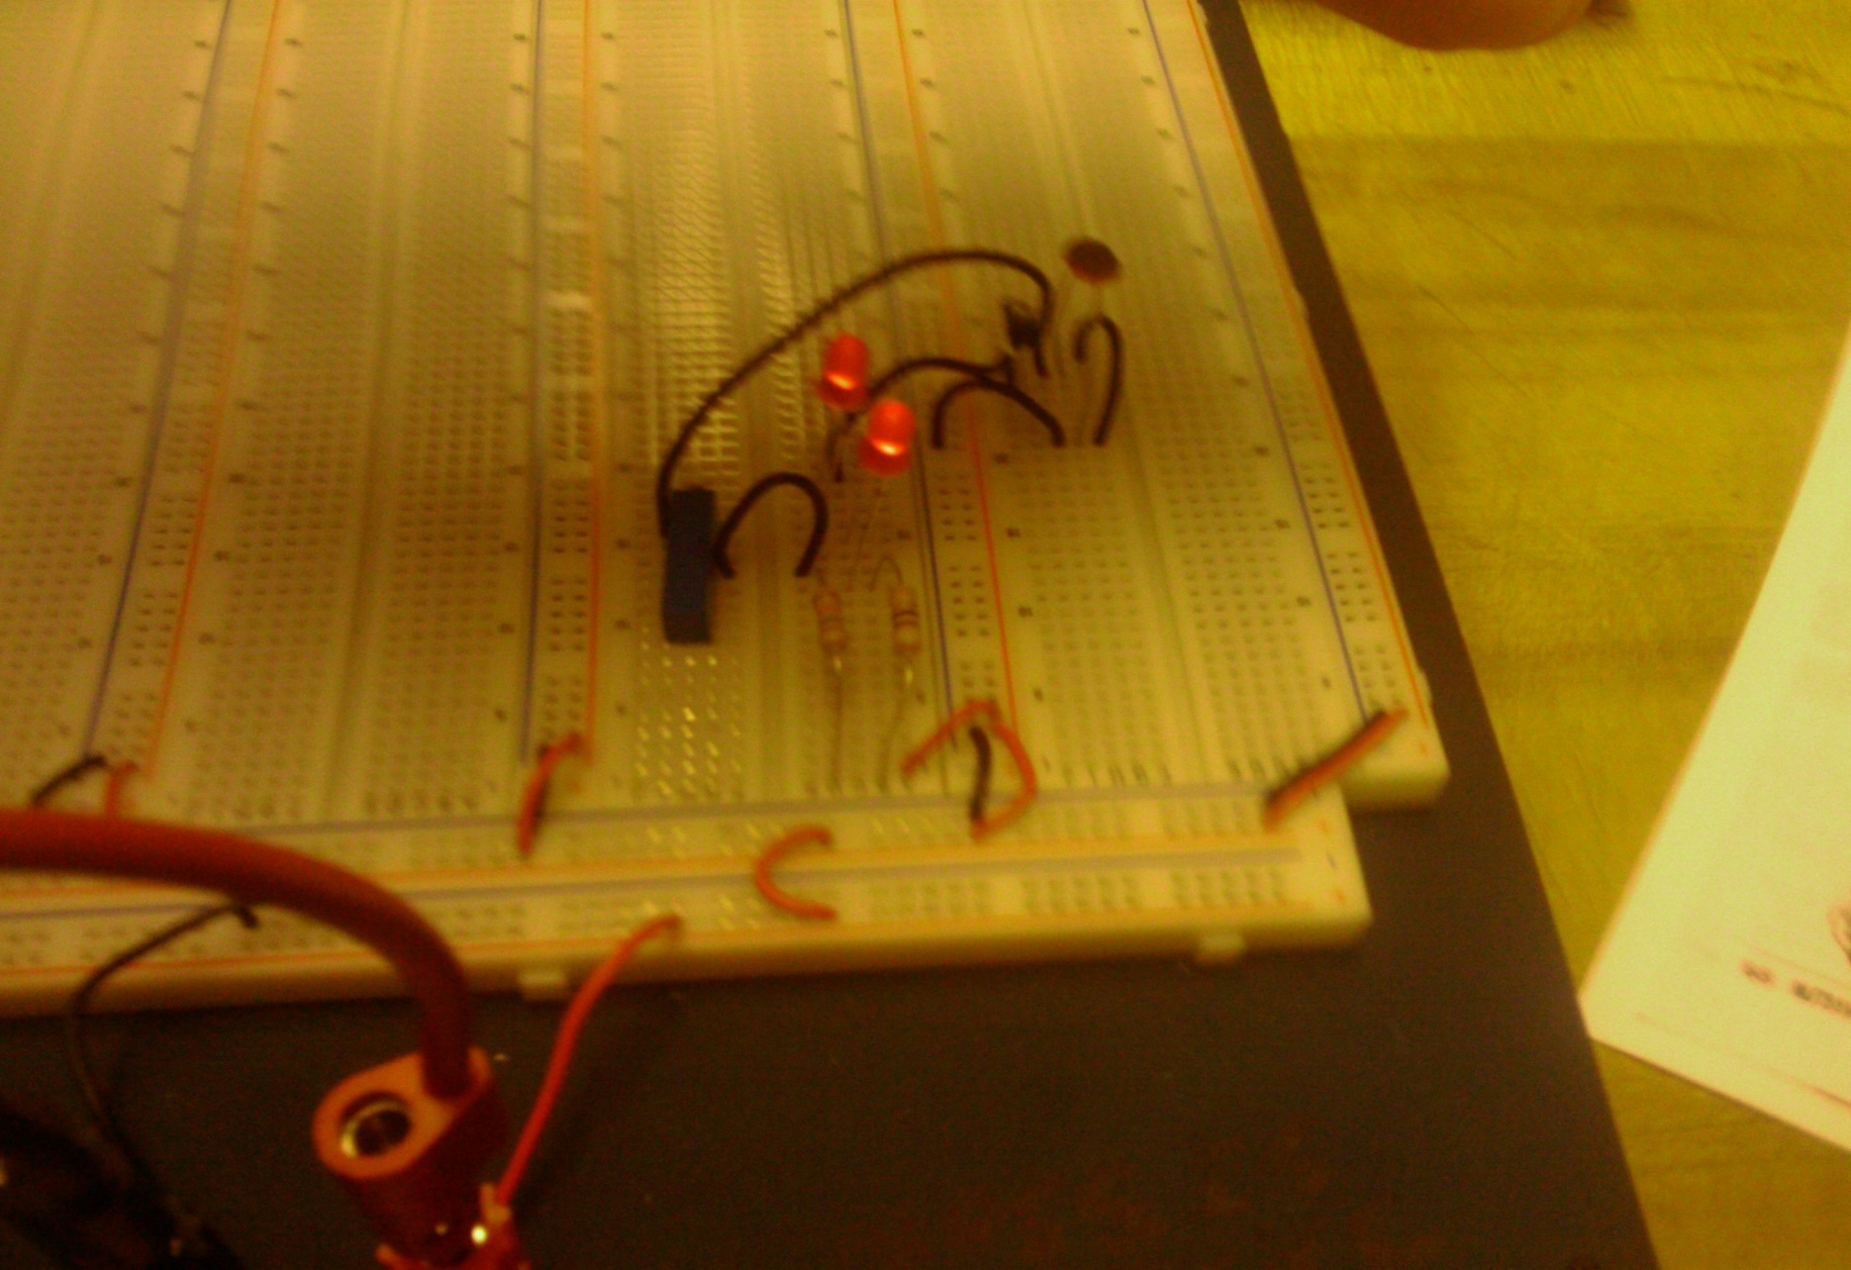
Photocell Lab - On

